Slide 1



Slide 2
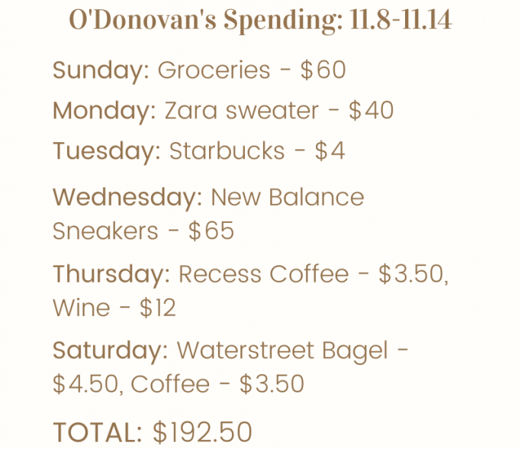

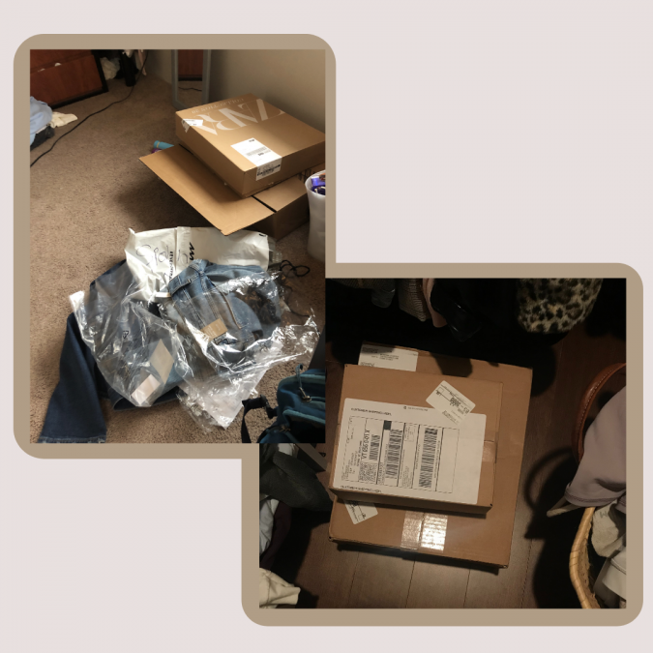
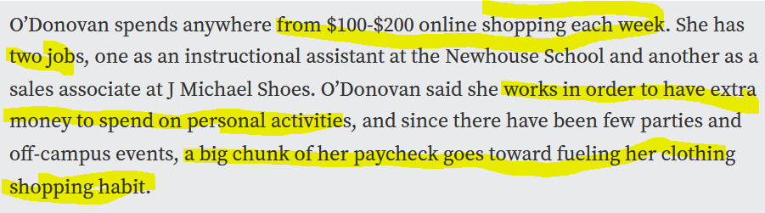
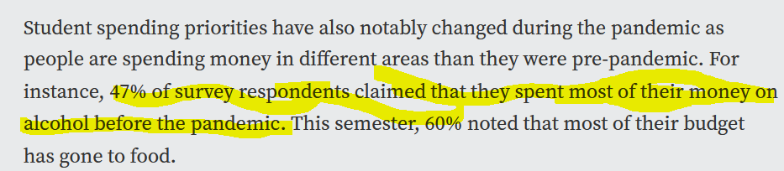
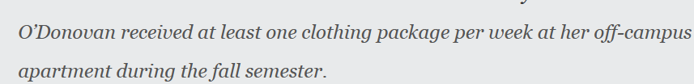
Problem
https://www.thenewshouse.com/life-and-style/how-covid-19-has-changed-student-spending-habits/

Slide 3

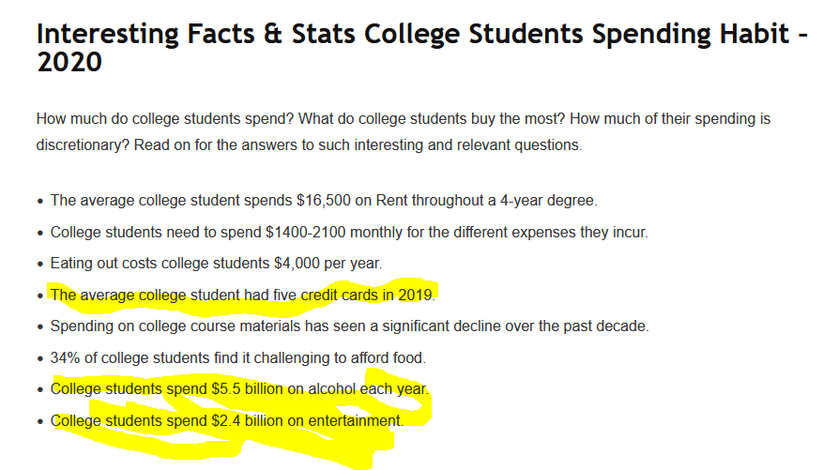
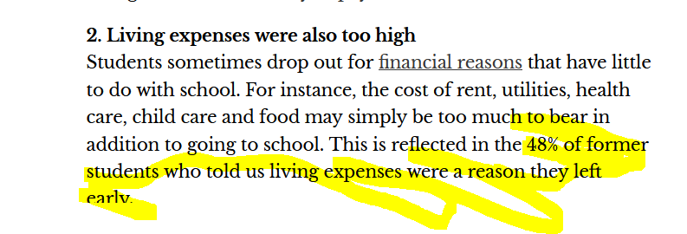
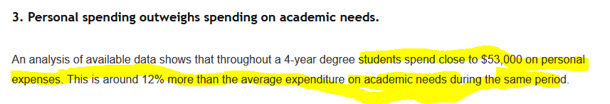
Problem
https://admissionsly.com/college-student-spending-statistics/
https://theconversation.com/why-community-college-students-quit-despite-being-almost-finished-175420

Slide 4
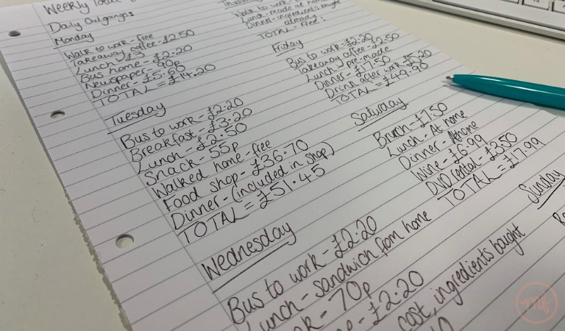
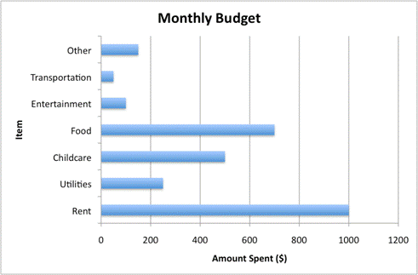
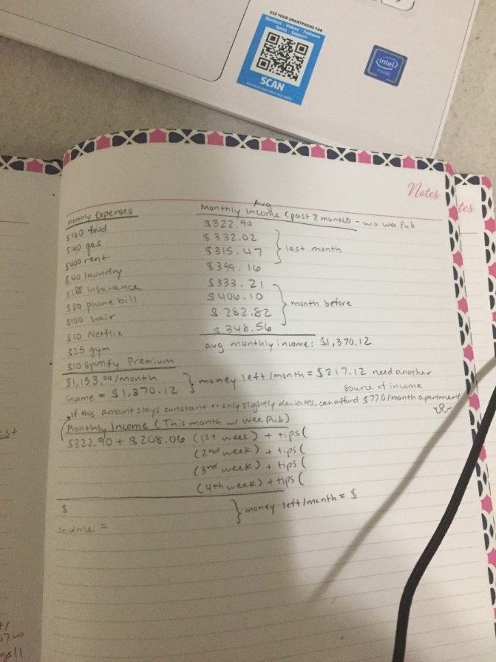
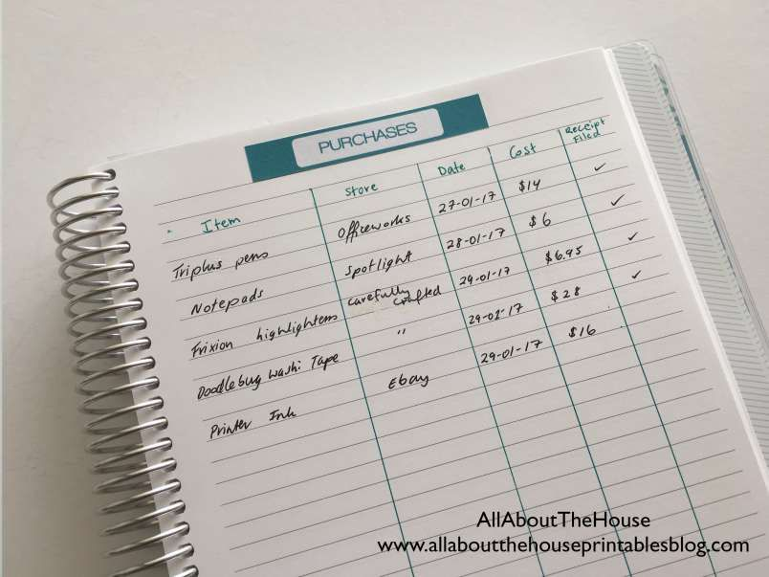
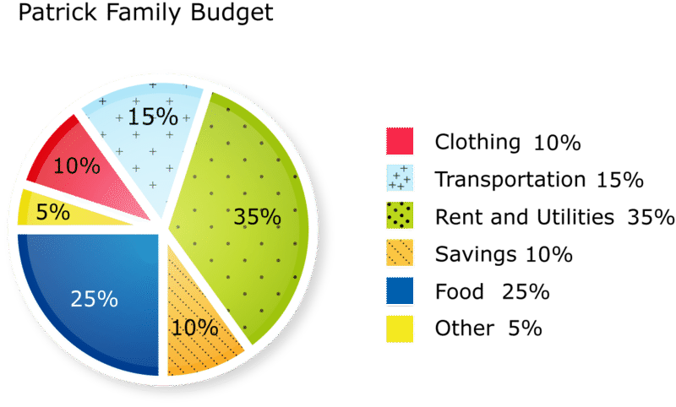
Solution
Transaction Recorder
vs

Slide 5
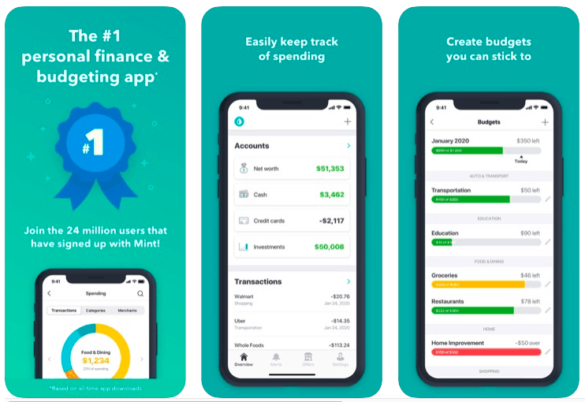
Solution
Finance Planer

Slide 6
Customer
B2C
Free for individual users
B2B
Monetise the application by leasing online ads
B2B2C
Act as bridge between individual users and potential finance services - small fee would be applied

Slide 7
Road Map
We are here
Application with transaction viewer
Graphics of the money spending based on categories
Test and prototype with the students about what to see and how to use
Get user feedback
Implement the feature to plan budget – financial planning
1 month
3 month
2 month
Implement user feedback
Marketing campaign
Test and prototype with the students about what to see and how to use
Get user feedback
1 month

